Slide 1
Foundations of Cybersecurity
Dr. Steven Cabrera
Spring Quarter 2025
4/5/2025

Slide 2
Day 1 Course Plan
Course Introduction
In-class Survey
Student Self-introductions
Cybersecurity Field Overview
Stallings Chapter 1: Best Practices, Standards, and a Plan of Action

Slide 3
Self-IntroDUCTIONS
Who you are
Where you’re from
What you hope to gain from this course
Past experience

Slide 4
Course Disclaimer
This course is not designed towards a specific security certification
The cybersecurity career field is extremely diverse & opportunities exist in nearly every industry.
This course is intended to provide a baseline introduction to the fundamentals and understandings required to pursue further study and interest in the cybersecurity field.

Slide 5
Career Fields in Cybersecurity
Chief Information Security Officer
Cybersecurity Director
Senior Manager – Cybersecurity
Manager – Cybersecurity
Information Systems Security Manager (ISSM)
Information Systems Security Officer (ISSO)
Information Systems Security Engineer (ISSE)
Security Analyst
Security Operations Center Analyst
Security Engineer
Cyber Threat Intelligence Analyst
Penetration Tester (Red Team)
Cybersecurity Architect
IT Auditor
Consultant
Digital Forensics

Slide 6



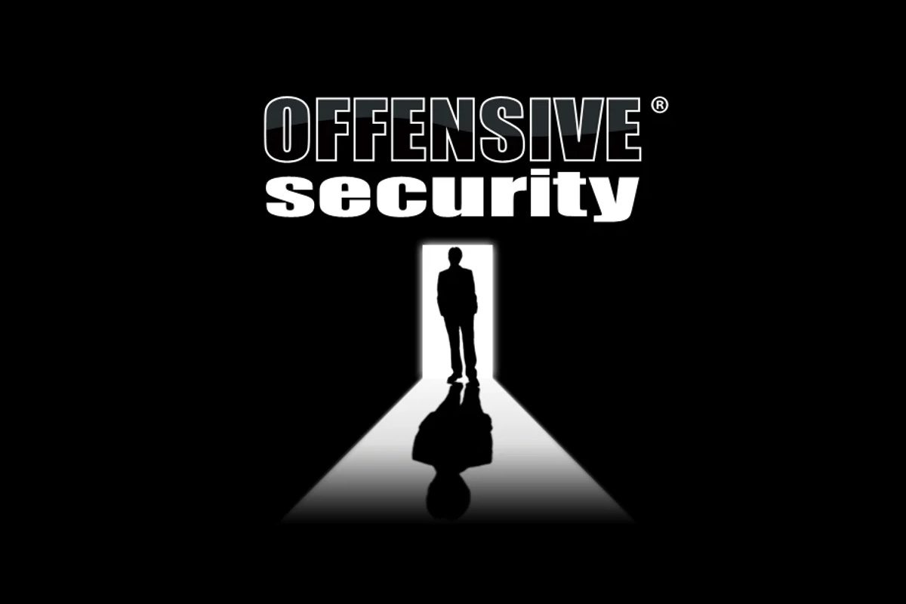

Available Certifications
CompTIA
Security+
CYSA+
PenTest+
ISC2
SSCP
CISSP
CCSP
EC-Council
CEH
LPT
CCISO
ISACA
CISM
CISA
CRISC
CGRC
CGEIT
OffSec
OSCP
OSCE
OSEE

Slide 7
Defining Cyberspace and Cybersecurity
Definition of cybersecurity as provided in ITU-T
“Cybersecurity is the collection of tools, policies, security concepts, security safeguards, guidelines, risk management approaches, actions, training, best practices, assurance and technologies that are used to protect the cyberspace environment and organization and user’s assets. Organization and user’s assets include connected computing devices, personnel, infrastructure, applications, services, telecommunications systems, and the totality of transmitted and/or stored information in the cyberspace environment. Cybersecurity strives to ensure the attainment and maintenance of the security properties of the organization and user’s assets against relevant security risks in the cyberspace environment. The general security objectives comprise the following: availability, integrity, which may include authenticity and non-repudiation; and confidentiality.”

Slide 8
Information Security
Network Security
Preservation of confidentiality, integrity, and availability of information
Other properties such as authenticity, accountability non-repudiation, and reliability can also be involved
Protection of networks and their services from unauthorized modification, destruction, or disclosure and provision of assurance that the network performs its critical function correctly and that there are no harmful side effects

Slide 9
Asset
Risk
Data contained in an information system; or a service provided by a system; or a system capability, such as processing power or communication bandwidth; or an item of system equipment (such as hardware, firmware, software, or documentation); or a facility that houses system operations and equipment
A measure of the extent to which an entity is threatened by a potential circumstance or event and typically a function of
the adverse impacts that would arise if the circumstance or event occurs
(2) the likelihood of occurrence

Slide 10


Chapter 1
Best Practices, Standards, and a Plan of Action

Slide 11
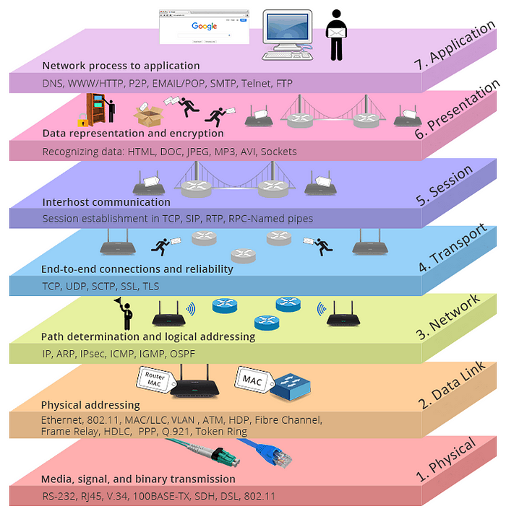
OSI Model
Application
Presentation
Session
Transport
Network
Data Link
Physical

Slide 13
Cybersecurity Objectives
Availability
The property of a system or a system resource being accessible or usable or operational upon demand, by an authorized system entity, according to performance specifications for the system
Integrity
The property that data has not been changed, destroyed, or lost in an unauthorized or accidental manner
Authenticity
The property of being genuine and being able to verify that users are who they say they are and that each input arriving at the system came from a trusted source
Non-repudiation
Assurance that the sender of information is provided with proof of delivery and the recipient is provided with proof of the sender’s identity, so neither can later deny having processed the information
Confidentiality
The property that data is not disclosed to system entities unless they have been authorized to know the data
Accountability
The property of a system or system resource ensuring that the actions of a system entity may be traced uniquely to that entity, which can then be held responsible for its actions

Slide 14
Cybersecurity Dilemmas
Scale and complexity of cyberspace
Is massive---cyberspace involves mobile devices, workstations, servers, massive data centers, cloud computing services, Internet of Things (IoT) deployments, and a wide variety of wired and wireless networks
Variety of individuals and applications requiring some level of access to these resources is also huge
The challenge to achieving cybersecurity constantly change as technologies advance, new applications of information technologies emerge, and societal norms evolve
Nature of the threat
Organizational assets in cyberspace are under constant and evolving threat from vandals, criminals, terrorists, hostile states, and other malevolent actors
A variety of legitimate actors, including businesses and governments, are interested in collecting, analyzing, and storing information from and about individuals and organization, potentially creating security and privacy risks
User needs versus security implementation
Users want technology with the most modern and powerful features, that is convenient to use, that offers anonymity in certain circumstances, and that is secure
The simpler the system, and the more its individual elements are isolated from one another, the easier it is to implement effective security
Users or groups within an organization that feel inconvenienced by security mechanisms will be tempted to find ways around those mechanisms or demand relaxation of the security requirements
Difficulty estimating costs and benefits
It is difficult to estimate the total cost of cybersecurity breaches and, therefore, the benefits of security policies and mechanisms

Slide 15
Threat
Vulnerability
A potential for violation of security that exists when there is a circumstance, a capability, an action, or an event that could breach security and cause harm
Basically, a threat is a possible danger that might exploit a vulnerability
A flaw or weakness in a system’s design, implementation, or operation and management that could be exploited to violate the system’s security policy

Slide 16
The Value of Standards and best practices documents
A number of organizations, based on wide professional input, have developed best practices types of documents as well as standards for implementing and evaluating cybersecurity
National Institute of Standards and Technology (NIST)
ITU-T
International Organization for Standardization (ISO)
Internet Society (ISOC)
A number of professional and industry groups have produced best practices documents and guidelines
The most important document is the Standard of Good Practice for Information Security, produced by the Information Security Forum (ISF)
This 300+ page document provides a wide range of best practices representing the consensus of industry and government organizations
Other respected organizations, including the Information Systems Audit and Control Association (ISACA) and the Payment Card Industry (PCI) have produced a number of similar documents

Slide 17
Table 1.1
Important Best Practices and Standards Documents

Slide 18
The standard of good practice for information security (SGP)
The ISF is an independent, not-for-profit association of leading organizations from around the world
ISF members fund and cooperate in the development of a practical research program in information security
It is dedicated to investing, clarifying, and resolving key issues in cybersecurity, information security, and risk management and to developing best practice methodologies, processes, and solutions that meet the business needs of its members
The most significant activity of the ISF is the ongoing development of the Standard of Good Practice for Information Security (SGP)
This document is a business-focused comprehensive guide to identifying and managing information security risks in organizations and their supply chains
The SGP is based on research projects and input from ISF members as well as analysis of the leading standards on cybersecurity, information security, and risk management

Slide 20
Security Policy
A set of rules and practices that specify or regulate how a system or organization provides security services to protect sensitive and critical system resources

Slide 21
SGP is of interest to the following individuals:
Chief information security officers (or equivalent)
Responsible for developing policy and implementing sound information security governance and information security assurance
Information security managers
Responsible for promoting or implementing an information security assurance program
Business managers
Responsible for ensuring that critical business applications, processes, and local environments on which an organization’s success depends are effectively managed and controlled
IT managers and technical staff
Responsible for designing, planning, developing, deploying, and maintaining key business applications, information systems, or facilities
Internal and external auditors
Responsible for conducting security audits
IT service providers
Responsible for managing critical facilities (for example, computer installations, networks) on behalf of the organization
Procurement and vendor management teams
Responsible for defining appropriate information security requirements in contracts

Slide 22
Table 1.2
ISF Standard of Good Practice for Information Security:
Categories and Areas
(Table is on pages 10-11 in the textbook)

Slide 24
The iso/iec 27000 suite of information security standards
ISO
Perhaps the most important set of standards for cybersecurity
Is an international agency for the development of standards on a wide range of subjects
Founded in 1946
It is a voluntary, nontreaty organization whose members are designated standards bodies of participating nations as well an nonvoting observer organizations
The U.S. member body is the American National Standards Institute (ANSI)
Has issued more than 12,000 standards in a broad range of areas
Its purposed is to promote the development of standardization and related activities to facilitate international exchange of goods and services and to develop cooperation in the sphere of intellectual, scientific, technological, and economic activity
One important area of ISO standardization deals with the Open System Interconnection (OSI) communications architecture and the standards at each layer of this architecture

Slide 25
The iso/iec 27000 suite of information security standards
IEC
International Electrotechnical Commission
Develops standards in a joint effort with ISO in the areas of data communications, networking, and security
Primarily concerned with electrical and electronic engineering standards
In the area of information technology the IEC emphasis is on hardware and the ISO emphasis is on software
In 1997 the two groups formed the Joint Technical Committee 1 (JTC 1)
This committee has the responsibility of developing the documents that ultimately become ISO (and IEC) standards in the area of information technology

Slide 26
The iso/iec 27000 suite of information security standards
The ISO and IEC have developed a growing family of standards in the ISO/IEC 27000 series that deal with ISMSs
Information security management system:
consists of the policies, procedures, guidelines, and
associated resources and activities, collectively managed
by an organization, in the pursuit of protecting its information assets.
An ISMS is a systematic approach for establishing, implementing, operating, monitoring, reviewing, maintaining and improving an organization’s information security to achieve business objectives.
It is based upon a risk assessment and the organization’s risk
acceptance levels designed to effectively treat and manage risks.

Slide 28
Security controls
The management, operational, and technical controls (that is, countermeasures) prescribed for an information system to protect the confidentiality, integrity, and availability of the system and its information

Slide 29
certification
The provision by an independent body of written assurance (a certificate) that the product, service, or system in question meets specific requirements; also known as third-party conformity assessment

Slide 30
Table 1.3
ISO 27001 Information Security Management Systems Requirements: Requirements Topics
(Table is on page 16 in the textbook)

Slide 31
Table 1.4
ISO 27002 Code of Practice for
Information Security Controls:
Control Topics
(Table is on pages 17-18 in the textbook)

Slide 32
Table 1.5
Mapping ISO 27001 to the ISF
Standard of Good Practice
(Table is on pages 18-19 in the textbook)

Slide 33
Table 1.6
Mapping ISO 27002
to the ISF Standard
of Good Practice
(Table is on pages 19-20 in the textbook)

Slide 34
Table 1.7
Breakdown of The SGP Threat
and Incident Management Category7Breakdown
(Table is on page 21 in the textbook)

Slide 35
NIST cybersecurity framework and security documents
NIST is a U.S. federal agency that deals with measurement science, standards, and technology related to the U.S. government and to the promotion of U.S. private sector innovation
NIST Federal Information Processing Standards (FIPS) and Special Publications (SP) have a worldwide impact
In the area of information security, the NIST Computer Security Resource Center (CSRC) is the source of a vast collection of documents that are widely used in the industry

Slide 37
Table 1.8
NIST
Cybersecurity
Framework
Functions
and
Categories
(Table is on page 23 in the textbook)

Slide 38
Table 1.9
Cybersecurity
Framework
Implementation
Tiers
(Table is on page 24-25 in the textbook)

Slide 39
countermeasure
An action, a device, a procedure, or a technique that reduces a threat, a vulnerability, or an attack by eliminating or preventing it, by minimizing the harm it can cause, or by discovering and reporting it so that corrective action can be taken

Slide 40
Nist security documents
SP 800-53, Security and Privacy Controls for Federal Information Systems and Organizations is by far the most significant document
This document lists management, operational, and technical safeguards or countermeasures prescribed for an information system to protect the confidentiality, integrity, and availability of the system and its information
Although intended for U.S. government systems, it is of equal applicability to IT systems in any organization
State-of-the-practice security controls and control enhancements have been integrated into the latest revision (2013) to address the evolving technology and threat space
The revision also features eight new families of privacy controls that are based on the internationally accepted fair information practice principles

Slide 41
Other documents of special interest include:
FIPS 200, Minimum Security Requirements for Federal Information and Information Systems (2006): Specifies minimum security requirements in 17 security-related areas with regard to protecting the confidentiality, integrity, and availability of federal information systems and the information processed, stored, and transmitted by those systems.
SP 800-100, Information Security Handbook: A Guide for Managers (2006): Provides a broad overview of information security program elements to assist managers in understanding how to establish and implement an information security program. Its topical coverage overlaps considerably with ISO 27002.
SP 800-55, Performance Measurement Guide for Information Security (2008): Provides guidance on how an organization, through the use of metrics, identifies the adequacy of in-place security controls, policies, and procedures.
SP 800-27, Engineering Principles for Information Technology Security: A Baseline for Achieving Security (2004): Presents a list of system-level security principles to be considered in the design, development, and operation of an information system.
SP 800-12, Introduction to Information Security, (2017): Provides an outstanding introduction to the topic of information security.
SP 800-144, Guidelines on Security and Privacy in Public Cloud Computing: Addresses the important security/privacy issues involved in moving data and applications to the cloud.

Slide 42
attack
Any kind of malicious activity that attempts to collect, disrupt, deny, degrade, or destroy information system resources or the information itself

Slide 43
The CIS critical security controls for effective cyber defense
The Center for Internet Security (CIS) is a nonprofit community of organizations and individuals seeking actionable security resources
The CIS identifies specific security techniques and practices that the CIS group of experts agree are important
A major contribution of CIS is The CIS Critical Security Controls for Effective Cyber Defense (CSC)
CSC focuses on the most fundamental and valuable actions that every enterprise should take
CSC is not simply a list of controls that might be useful but a source that can be used to guide implementation of policy
Controls listed in the CSC are designed to be the most effective and specific technical measures available to detect, prevent, respond to, and mitigate damage from the most common to the most advanced attacks

Slide 44
Table 1.10
The CIS
Critical Security
Controls List of
Controls for Effective Cyber Defense

Slide 45
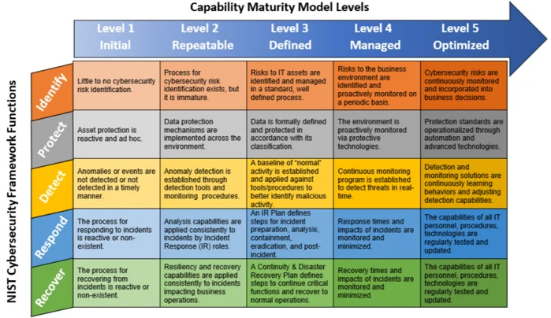

Slide 46
Critical security controls
Each control section includes the following:
A description of the importance of the control in blocking or identifying the presence of attacks and an explanation of how attackers actively exploit the absence of this control
A chart of the specific actions, called sub-controls, that organizations are taking to implement, automate, and measure the effectiveness of this control
Procedures and tools that enable implementation and automation
Sample entity relationship diagrams that show components of implementation

Slide 47
Cobit 5 for information security
Control Objectives for Business and Related Technology (COBIT) is a set of documents published by ISACA
ISACA is an independent, nonprofit, global association engaged in the development, adoption, and use of globally accepted, industry-leading knowledge and practices for information systems
COBIT 5 is the fifth version of the set of documents to be released and is intended to be a comprehensive framework for the governance and management of enterprise IT

Slide 48
Table 1.11
COBIT 5 for
Information Security:
Main Policies and
Functions
(Table is on pages 29-30 in the textbook)

Slide 49
COBIT 5 also provides a useful organization of the techniques used to achieve effective security into 5 domains and 37 processes, under two general categories:
Governance of Enterprise IT
Evaluate, Direct and Monitor (EDM): 5 processes
Management of Enterprise IT
Align, Plan and Organize (APO): 13 processes
Build, Acquire and Implement (BAI): 10 processes
Deliver, Service and Support (DSS): 6 processes
Monitor, Evaluate and Assess (MEA): 3 processes

Slide 50
Payment card industry data security standard (pci Dss)
The PCI-DSS, a standard of the PCI Security Standards Council, provides guidance for maintaining payment security
The standard sets the technical and operational requirements for organizations accepting or processing payment transactions and for software developers and manufacturers of applications and devices used in those transactions
PCI DSS compliance governs the way payment card data is processed, handled, and stored
It is required for merchants and all businesses that touch payment data in any way

Slide 51
The PCI defines the scope of the PCI DSS as follows:
The PCI DSS security requirements apply to all system components included in or connected to the cardholder data environment. The cardholder data environment (CDE) is comprised of people, processes and technologies that store, process, or transmit cardholder data or sensitive authentication data. “System components” include network devices, servers, computing devices, and applications.

Slide 52
Goals | PCI-DSS Requirements
Build and Maintain a Secure Network and Systems | 1. Install and maintain a firewall configuration to protect cardholder data 2. Do not use vendor-supplied defaults for system passwords and other security parameters
Protect Cardholder Data | 3. Protect stored cardholder data 4. Encrypt transmission of cardholder data across open, public networks
Maintain a Vulnerability Management Program | 5. Protect all systems against malware and regularly update anti-virus software or programs 6. Develop and maintain secure systems and applications
Implement Strong Access Control Measures | 7. Restrict access to cardholder data by business need to know 8. Identify and authenticate access to system components 9. Restrict physical access to cardholder data
Regularly Monitor and Test Networks | 10. Track and monitor all access to network resources and cardholder data 11. Regularly test security systems and processes
Maintain an Information Security Policy | 12. Maintain a policy that addresses information security for all personnel
Table 1.12
PCI DSS
Requirements
(Table is on page 31 in the textbook)

Slide 53
ITU-T security documents
The International Telecommunication Union (ITU) is a United Nations specialized agency
The members of ITU-T are governments
The U.S. representation is housed in the Department of State
The ITU’s charter states that it is “responsible for studying technical, operating, and tariff questions and issuing Recommendations on them with a view to standardizing telecommunications on a worldwide basis”
Its primary objective is to standardize, to the extent necessary, techniques and operations in telecommunications to achieve end-to-end compatibility of international telecommunication connections, regardless of the countries of origin and destination

Slide 54
Table 1.13
Key Topics by ITU-T
Security Recommendations
(continued)

Slide 55
Table 1.13
Key Topics by ITU-T
Security Recommendations
(Table is on pages 32-34 in the textbook)

Slide 58
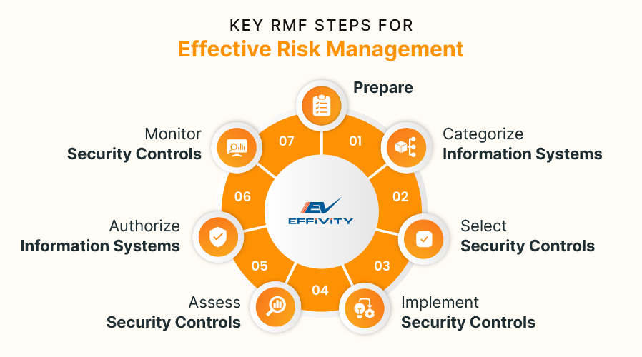

Slide 59
summary
The role of the National Institute of Standards and Technology (NIST) Cybersecurity Framework and how it differs from the objectives of ISO 27002
The value of the Center for Internet Security (CIS) Critical Security Controls
The need for standards and best practices documents in cybersecurity
Standard of Good Practice for Information Security
Differences between ISO 27001 and ISO 27002

